Slide 1
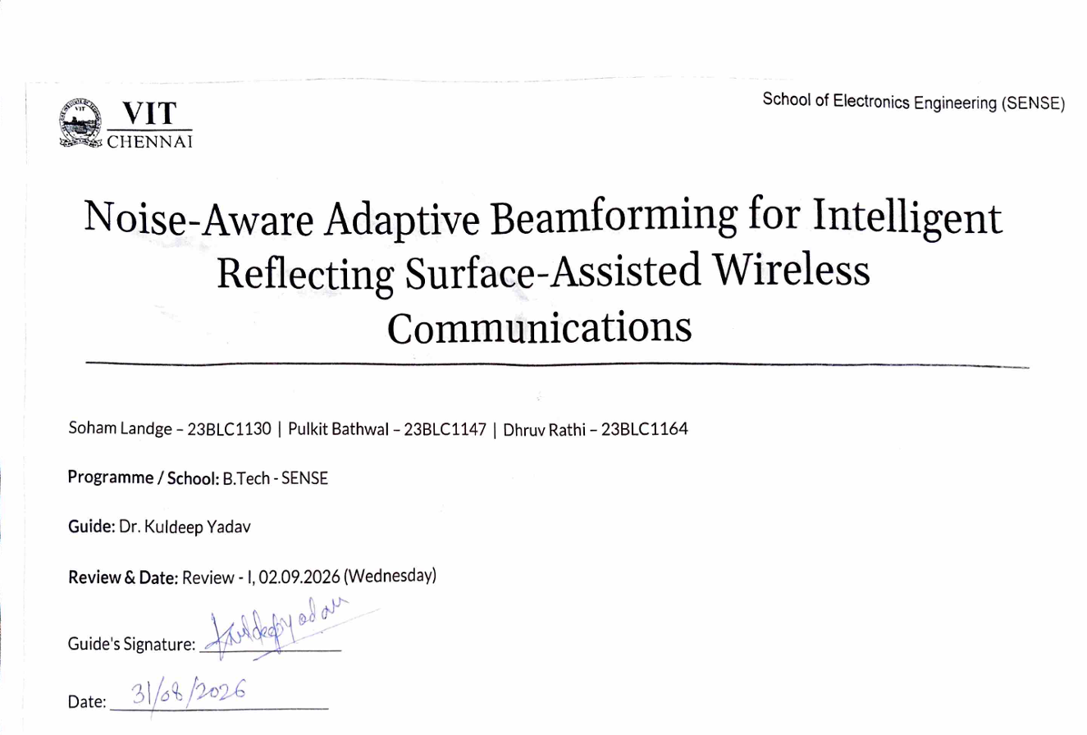

Slide 2


Problem & Motivation
Problem statement
Research question
Why IRS?
IRS-assisted links require accurate CSI; noisy pilots → imperfect CSI → degraded beamforming → sum-rate loss.
Can IRS beamforming remain robust when CSI is noise-limited? — emphasise "noise-aware".
Passive programmable reflection · coverage extension · spectral & energy efficiency · relevant to 6G/mmWave.
Real-world issue
Limited pilots · receiver noise floor · channel-estimation error — separate H/G recovery can amplify noise.
Visual contrast: PERFECT CSI assumption → REALISTIC NOISY CSI

Slide 3
Literature Survey
No. | Author(s) & Year | Topic / Source | Method / Key finding / Gap
1 | Q. Wu and R. Zhang, IEEE TWC, 2019 | IRS-assisted beamforming | Optimisation baselines; often assumes perfect CSI
2 | Z.-Q. He and X. Yuan, IEEE Wireless Commun. Lett., vol. 9, no. 2, pp. 210–214, 2020 | Cascaded channel estimation | Separate H/G recovery; potential noise amplification
3 | G. Zhou, C. Pan, H. Ren, K. Wang, M. Di Renzo, A. Nallanathan, arXiv:2001.07054 (IEEE Trans. Signal Process., 2020) | Robust beamforming | Robust optimisation under imperfect CSI; limited noise-aware pipelines
4 | M. Eisen and A. Ribeiro, IEEE Trans. Signal Process., vol. 68, pp. 2977–2991, 2020 | GNN for wireless resource allocation | Promising but application to noisy IRS estimation is limited
5 | Cao, Lv & Ni — PIMRC 2020 | Foundational IRS formulation | Reference system model for many follow-ups
6 | Q. Wu and R. Zhang, arXiv:1810.10718 (IEEE Trans. Commun., 2020) | Phase-shift quantization | Practical discrete IRS design considerations
7 | K. Guo, X. Liu, Y. Zhang et al., IEEE TWC, 2022 | AO / SDR baselines | Computational benchmarks; rely on CSI quality
8 | C. Liu, X. Liu, D. W. K. Ng, J. Yuan, IEEE Trans. Wireless Commun., vol. 21, pp. 898–912, 2021 | Noise-aware estimation | Gap: integrated noise-aware estimation + beamforming scant

Slide 4
Existing Solutions → Limitations
Perfect‑CSI AO / SDR
Separate H and G estimation
Optimization without noise‑aware learning
Strength: strong optimization benchmark
Limitation: assumes perfect CSI (unrealistic in noisy pilots)
Strength: conventional formulation
Limitation: dividing by small coefficients amplifies noise
Strength: established computational baselines
Limitation: does not learn robustness from noisy observations
G = BS → IRS channel matrix (dimension M×N: M = IRS elements = 64, N = BS antennas = 8)
H = IRS → user-k channel vector (dimension M×1)
THE GAP
Noisy pilots → imperfect CSI → beamforming degradation. Need integrated noise-aware pipeline estimating cascaded channel directly.

Slide 5

Proposed Solution & Methodology
Channel+Noise Sim
Noise-Aware GNN
LS Cascaded Est
Monte Carlo Eval
Applying cascaded least squares estimation techniques.
Evaluating performance through Monte Carlo methods.
Simulating channel conditions and noise interference.
Utilising a noise-aware graph neural network.
Key parameters
Methodological insight
N=8 (BS), M=64 (IRS), K=4 (users), K-factor=10, αBI=2.2, αIU=3.5, noise floor = −85 dBm
Estimate cascaded channel directly: C_k = diag(conj(h_k)) G — avoids unstable H/G division and noise amplification.

Slide 6
Project Scope & System Model
Channel models
BS–IRS: Rician (LOS)
IRS–User: Rayleigh (NLoS)
Path-loss: PL(d)=C0(d/d0)^{-α}
In scope
Python simulation
Cascaded C_k estimation
MATLAB/CVX baselines
Planned: GNN, Monte Carlo, quantization

Slide 7
50% Complete — Timeline & Tools
Phase 1 — COMPLETE
Channel & pilot simulation, SNR measurement, sanity checks (Python).
Phase 2 — COMPLETE
Cascaded C_k LS estimation, AO baselines, MATLAB/CVX verification.
Phase 3 — NEXT
GNN noise‑aware learning (planned)
Phases 4 — FUTURE
Monte Carlo sweeps, pilot/noise studies, discrete phase quantization.
Tools: Python (NumPy, SciPy, Matplotlib) · MATLAB (AO, CVX) · Git/GitHub

Slide 8
What Has Been Verified?
01 — Physical model
02 — Noise model
03 — Cascaded estimation
Channel dims, complex values, Rician/Rayleigh behaviour and expected path-loss validated.
Fixed absolute noise floor; received SNR emerges correctly; higher noise → expected SNR degradation.
Direct C_k LS recovery algebraically consistent with reference formulation; numerical agreement within machine precision.
Important conceptual point: estimating C_k directly avoids unstable division by small channel coefficients and associated noise amplification.

Slide 9
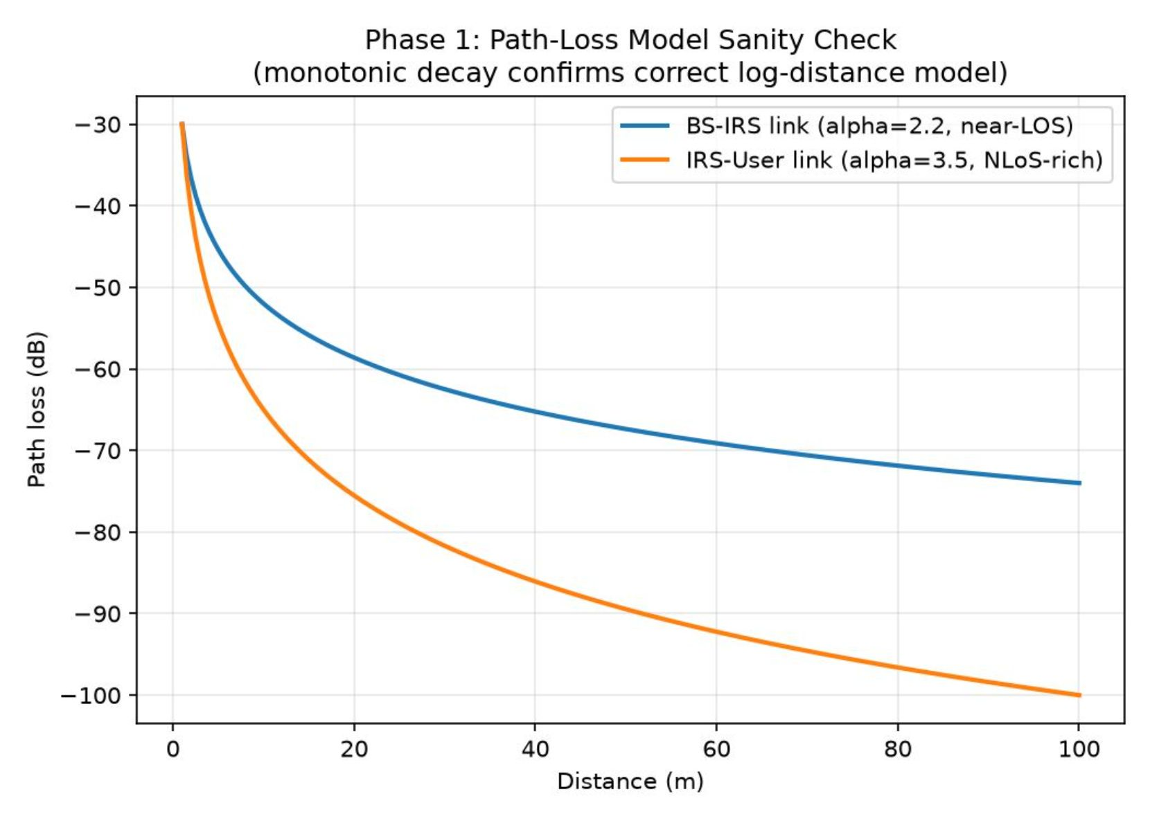
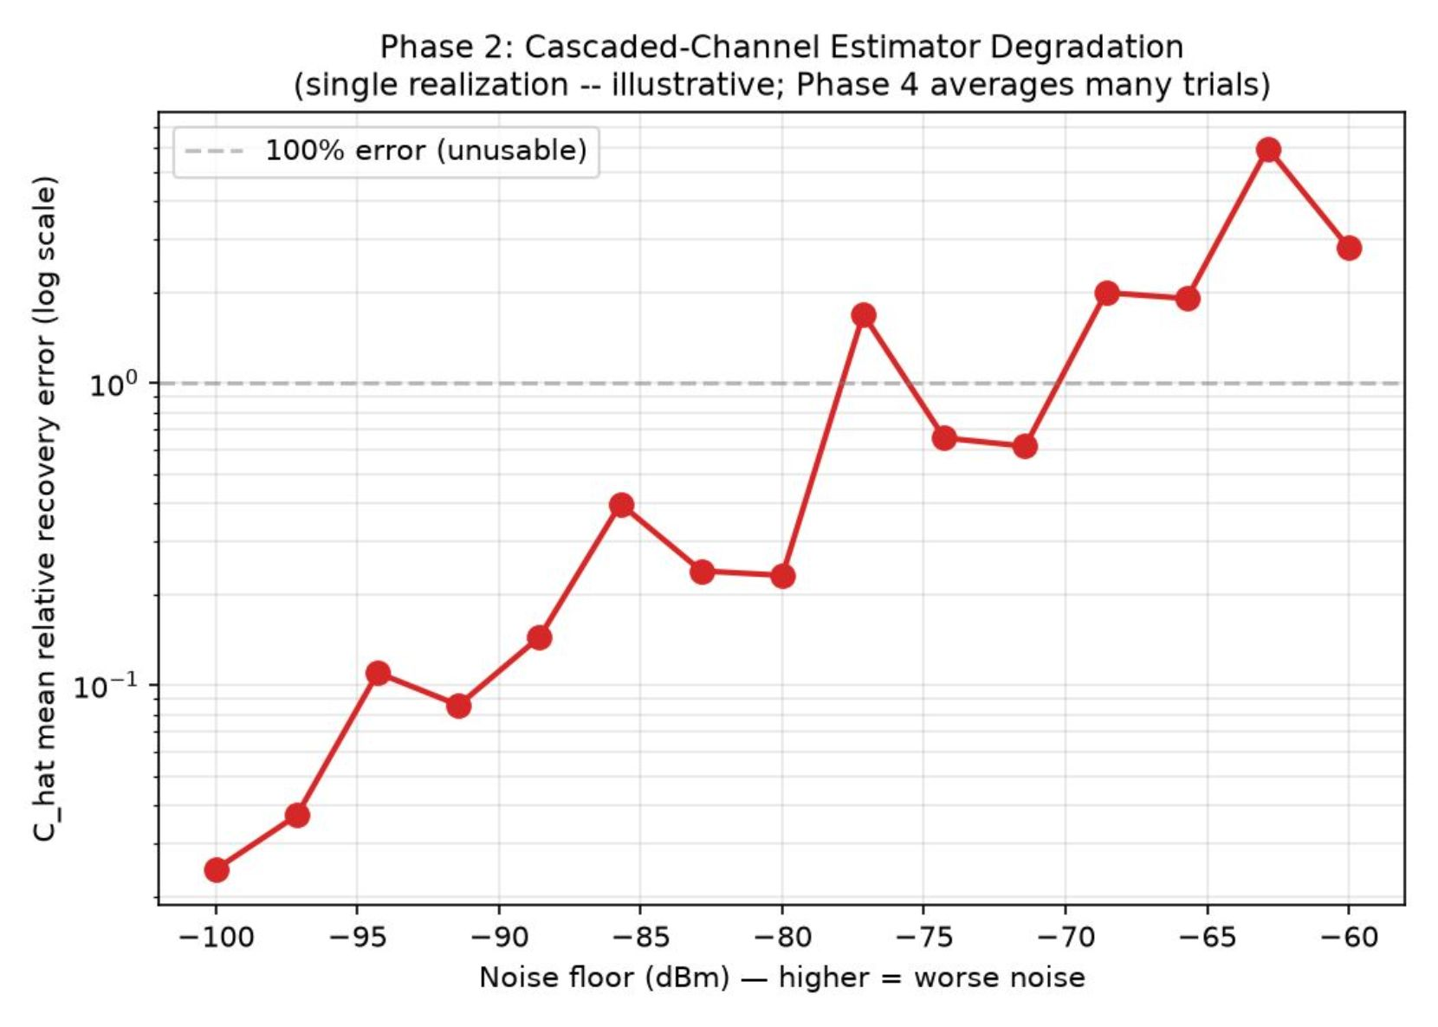
Results — Phase 1 & Phase 2
Figure 1 — Path-loss sanity check
BS–IRS α=2.2 · IRS–User α=3.5 · expected monotonic decay · illustrative sanity check.
Figure 2 — Ĉ recovery vs noise
Recovery error increases as noise floor worsens — single-realization illustrative verification (Monte Carlo planned in Phase 4).

Slide 10
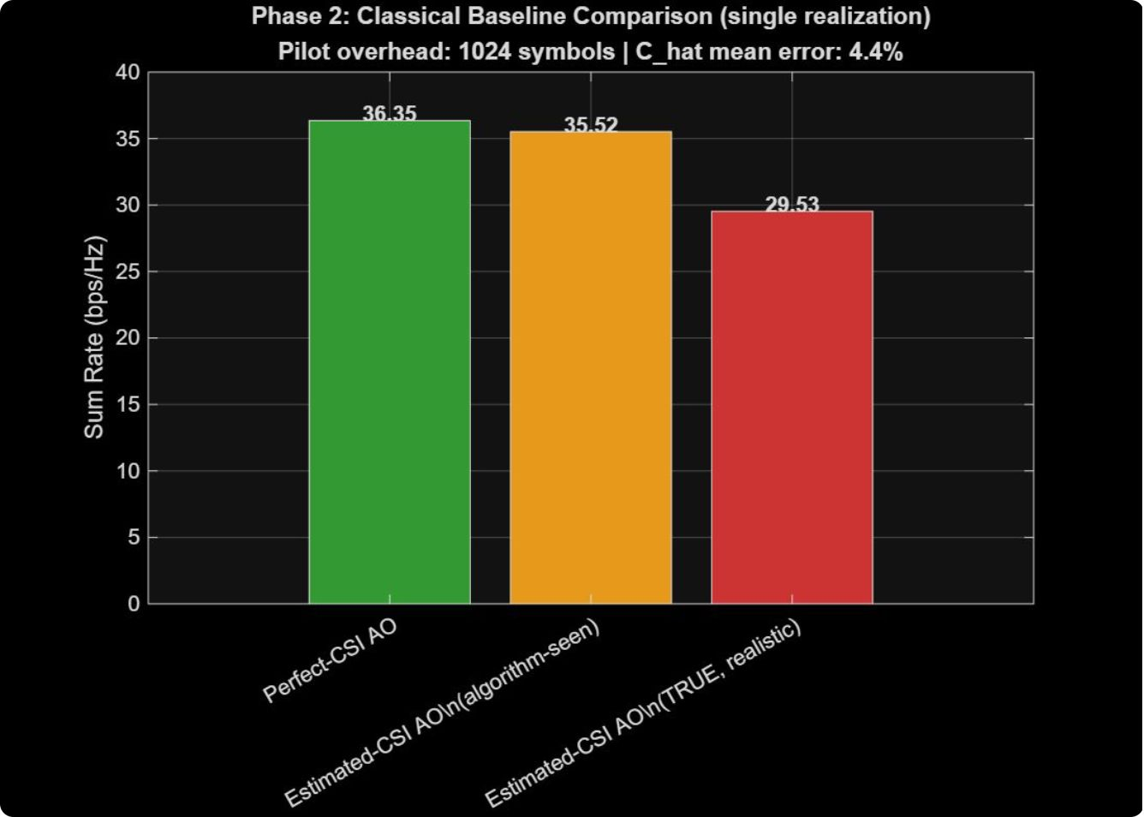
Results — AO Baseline, Takeaway & Next
Figure — Phase‑2 AO comparison (single realization)
Reported values
Additional metrics
Takeaway
36.35 bps/Hz — Perfect‑CSI AO
35.52 bps/Hz — Estimated‑CSI AO (algorithm‑seen)
29.53 bps/Hz — Estimated‑CSI AO (TRUE realistic evaluation)
Ĉ mean recovery error ≈ 4.4% · Pilot overhead = 1024 symbols
Imperfect CSI produces a measurable sum‑rate penalty — motivates noise‑aware learning (Phase 3).

Slide 11
References
[1] Q. Wu and R. Zhang, "Intelligent Reflecting Surface Enhanced Wireless Network via
Joint Active and Passive Beamforming," IEEE Trans. Wireless Commun., vol. 18,
no. 11, pp. 5394–5409, Nov. 2019.
[2] Z.-Q. He and X. Yuan, "Cascaded Channel Estimation for Large Intelligent
Metasurface Assisted Massive MIMO," IEEE Wireless Commun. Lett., vol. 9, no. 2,
pp. 210–214, Oct. 2020.
[3] G. Zhou, C. Pan, H. Ren, K. Wang, M. Di Renzo, and A. Nallanathan, "A Framework
of Robust Transmission Design for IRS-Aided MISO Communications With Imperfect
Cascaded Channels," IEEE Trans. Signal Process., 2020, arXiv:2001.07054.
[4] M. Eisen and A. Ribeiro, "Optimal Wireless Resource Allocation With Random Edge
Graph Neural Networks," IEEE Trans. Signal Process., vol. 68, pp. 2977–2991, 2020.
[5] J. Cao, J. Lv, and S. Ni, "A foundational framework for intelligent reflecting
surface-assisted wireless communication systems," in Proc. IEEE PIMRC, London,
UK, Aug.–Sept. 2020, pp. 1–6.
[6] Q. Wu and R. Zhang, "Beamforming Optimization for Intelligent Reflecting Surface
with Discrete Phase Shifts," IEEE Trans. Commun., 2020, arXiv:1810.10718.
[7] K. Guo, X. Liu, Y. Zhang, and Z. Ding, "Joint Beamforming for IRS-Aided Multi-Cell
MISO System: Sum Rate Maximization and SINR Balancing," IEEE Trans. Wireless
Commun., 2022.
[8] C. Liu, X. Liu, D. W. K. Ng, and J. Yuan, "Deep Residual Learning for Channel
Estimation in Intelligent Reflecting Surface-Assisted Multi-User Communications,"
IEEE Trans. Wireless Commun., vol. 21, pp. 898–912, 2021.

Slide 12
Thank You

